Slide 1
Federated Learning for Internet of Things: A Comprehensive Survey
By Team 5
Vyash Natarajan -1002060598
Ashlesha Gottipati - 1002169547
Venkatesh Nangi-1002068000
Manav Jayeshbhai Patel - 1002155843
Prajakta More - 1001924287

Slide 2
Introduction
Internet of Things (IoT): Proliferation of intelligent devices and services enabled by ubiquitous sensing and computing capabilities.
Need for Intelligent IoT Applications: Leveraging Artificial Intelligence (AI) techniques like Machine Learning (ML) and Deep Learning (DL) to extract insights from IoT data.
Challenges of Traditional Centralized AI Approaches: Issues with massive data offloading, limited computing resources at the cloud, and growing privacy concerns.
Motivation: Explore innovative AI solutions to realize efficient and privacy-enhanced intelligent IoT networks and applications.

Slide 3
What is Federated Learning?
Federal learning is collaborative decentralized learning for machine learning that allows for smarter models, lower latency, and less power consumption, all well and trained user privacy.
Key Concept of FL: Distributed collaborative AI training without sharing raw data.
Entities in an FL System: IoT devices as clients and a central aggregator.
FL Training Process: Local model training at clients, model updates transmission, and global model aggregation.
Advantages of FL: Privacy enhancement, reduced communication, and improved learning quality.

Slide 4
Why Federated Learning for IoT Services?
Data Privacy Enhancement: FL enables AI training without the need to share raw data, minimizing the risk of sensitive information leakage.
Low-Latency Network Communication: Reduced data offloading requirements in FL lead to lower communication latency and network resource savings.
Enhanced Learning Quality: Leveraging diverse datasets and computing resources from multiple IoT devices can improve the convergence rate and learning accuracy of the overall training process.
Scalability and Flexibility: The distributed and collaborative nature of FL makes it well-suited for the large-scale and dynamic nature of modern IoT networks.

Slide 5
How does Federated Learning Work?
Federated Learning (FL) decentralizes machine learning by keeping user data on devices, enhancing privacy and reducing network-related issues.
In this approach, a model is distributed from a server to client devices, which locally update the model using their own data but only send model improvements like weights and biases back to the server.
These updates are aggregated to refine the model across multiple iterations. For added security, secure aggregation techniques obfuscate the data with random values during transmission, ensuring updates remain anonymous.
This emerging approach promises significant improvements in privacy and efficiency for machine learning applications.

Slide 6
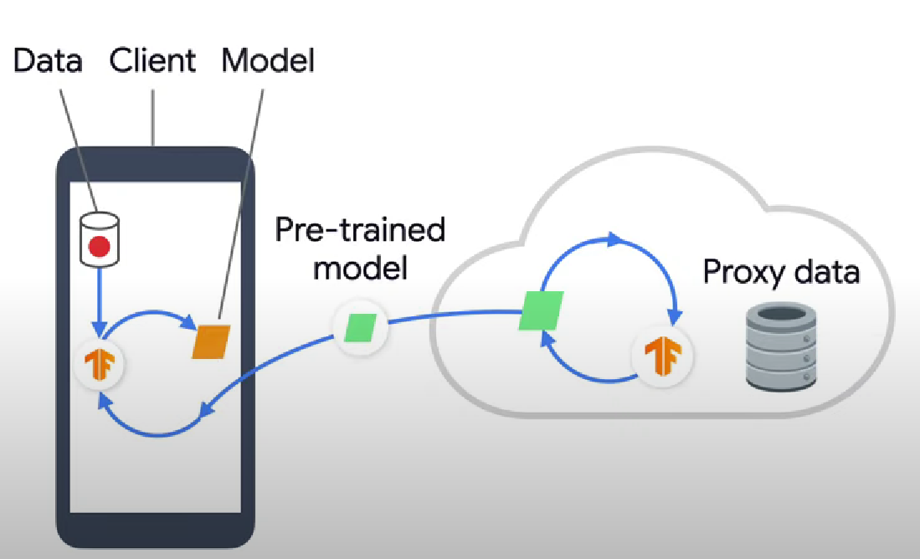
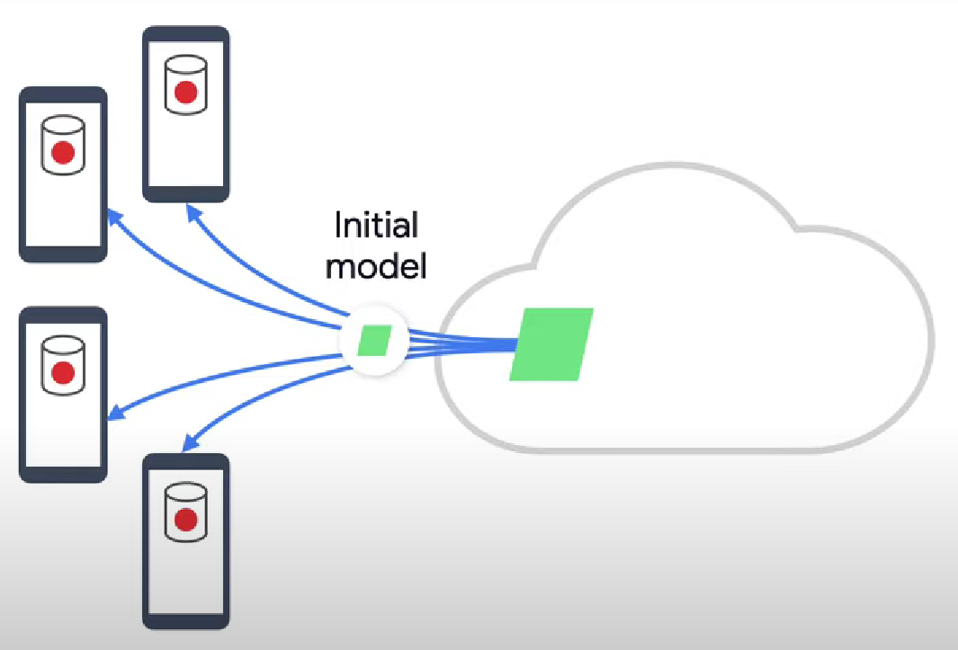
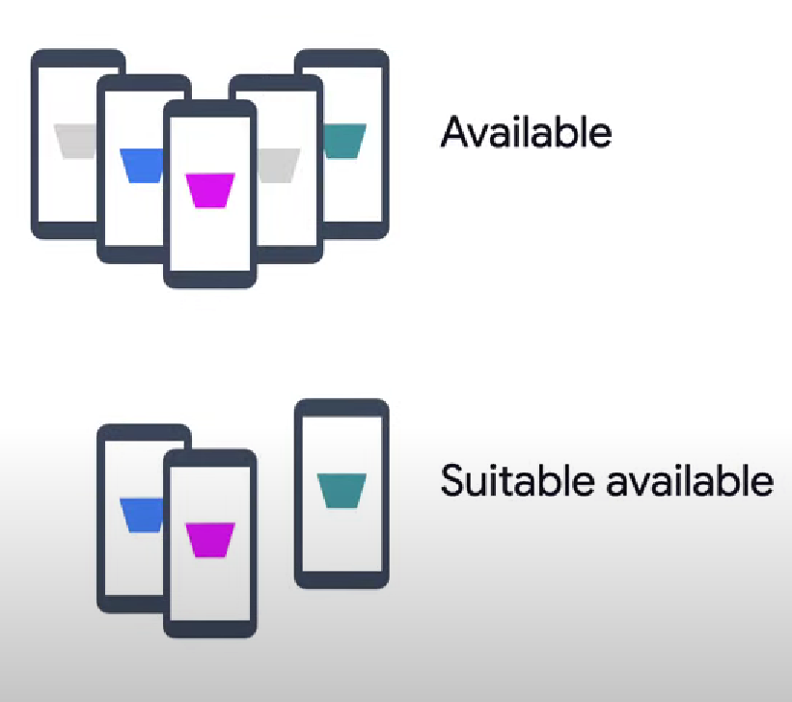
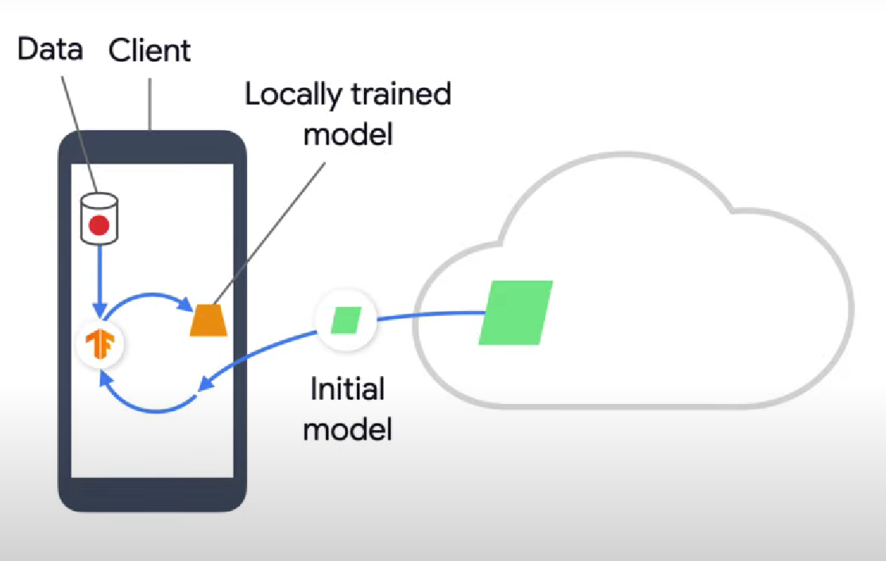
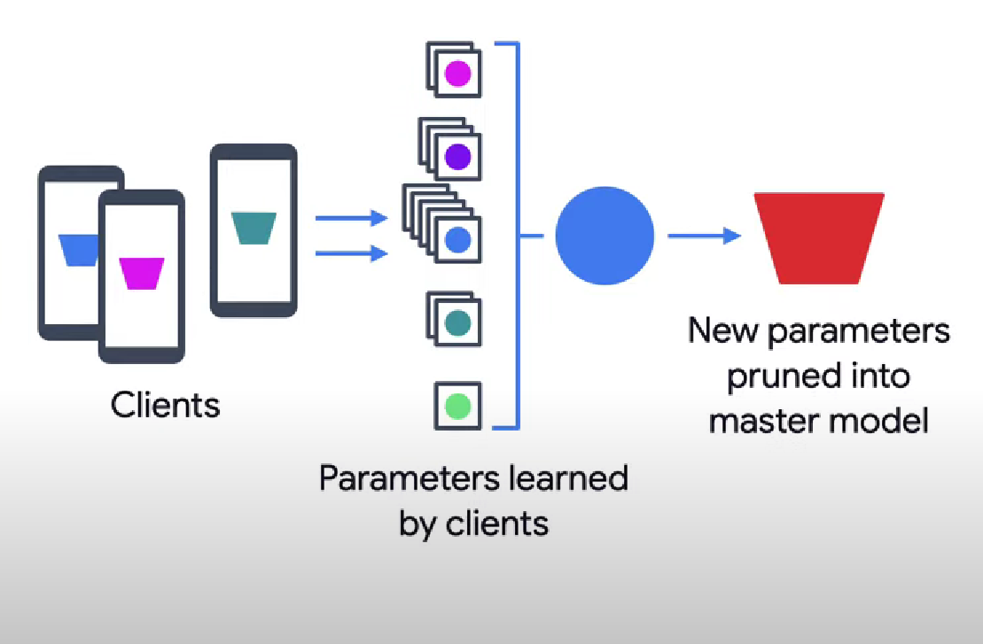
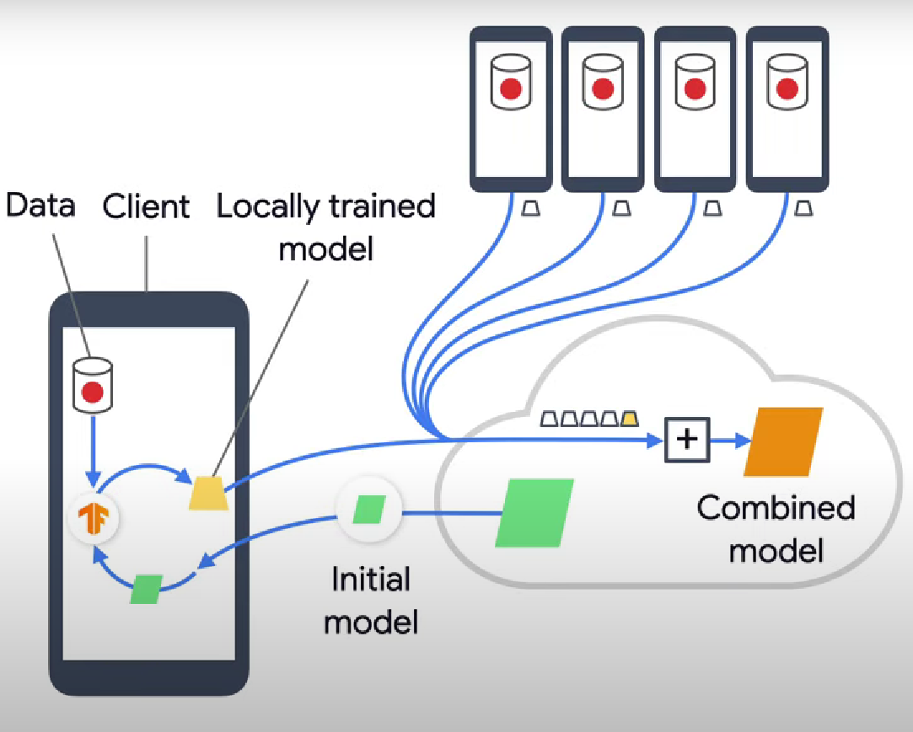
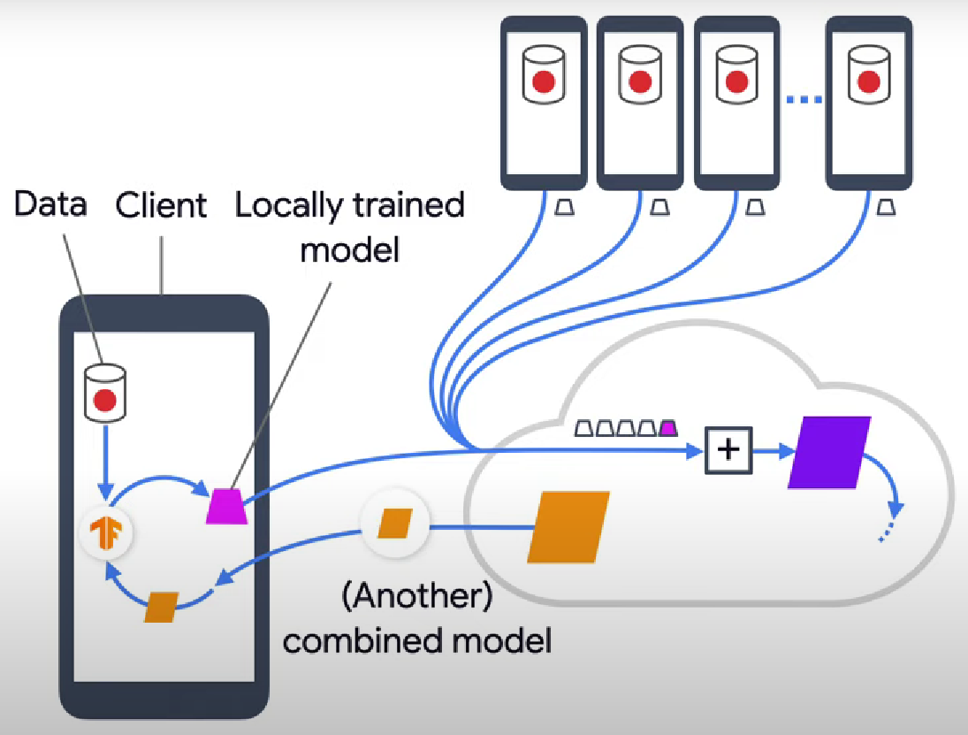
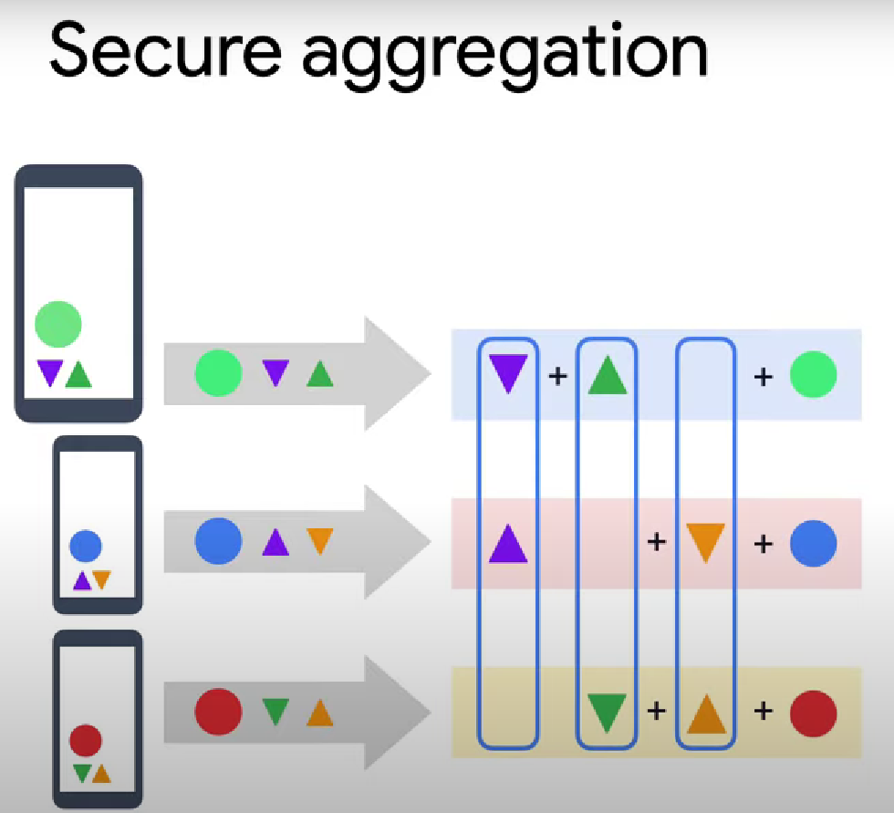

Slide 7
FEDERATED LEARNING IMPLEMENTATION IN IOT SERVICES
Federated learning offers a solution by enabling AI models to be trained directly on IOT devices. This approach keeps the data localized , enhancing privacy and reducing the need for large bandwidth to transfer data to central servers.
KEY IOT SERVICES ENHANCED BY FEDERATED LEARNING:
Data Sharing : FL facilitates a secure method for IoT devices to share insights derived from data through model updates without exposing the raw data itself, enhancing security and collaborative intelligence.
Data offloading and Caching : By optimizing how data is offloaded and cached, FL helps in effectively managing network resources and reducing response times within IoT systems.

Slide 8
CONT…
Attack Detection : FL allows for distributed security monitoring, enabling IoT devices to detect anomalies and potential threats locally, without the need to centralize sensitive data.
Localization and Mobile Crowdsensing : FL supports privacy-preserving localization and crowdsensing applications, allowing devices to contribute to data collection and analysis without disclosing precise location details.

Slide 9
APPLICATION OF IOT SERVICES USING FEDERATED LEARNING
FEDERATED LEARNING IN SMART HEALTHCARE
ELECTRONIC HEALTH RECORDS(EHRs) MANAGEMENT:
FL enables multiple healthcare institutions to collaborate in training models using local EHRs without sharing the actual data, preserving patient privacy.
Utilizes techniques like data perturbation to prevent model memorization attacks, thus protecting sensitive patient information.
Enhances the accuracy of clinical predictions and enables the use of advanced AI without risking data exposure.

Slide 10
CONT…
Collaborative Healthcare Services:
Allows different healthcare providers to collaborate by sharing model parameters instead of sensitive patient records, improving diagnostics and treatment plans.
Particularly beneficial for rare diseases or complex conditions where aggregated insights can lead to superior healthcare outcomes.
Facilitates remote monitoring and personalized medicine by training models on diverse datasets, making them more adaptable and effective across various patient demographics.

Slide 11
BENEFITS of FL IN HEALTHCARE
CHALLENGES
Model Robustness and Generalization: Learning from diverse data sources improves model robustness and its ability to generalize across different patient groups.
Regulatory Compliance: Aligns with strict healthcare regulations like HIPAA by minimizing data sharing and central processing.
Privacy and Security: Keeps health information localized and secure, significantly reducing breach risks.
Integration and Standardization: Integrating FL requires overcoming data heterogeneity and ensuring compatibility across different healthcare systems.
Scalability and Performance: Must ensure FL models are scalable and perform efficiently, crucial for handling real-time health data.
Reliability of Contributions: Important to verify the quality and reliability of data from various sources to maintain model accuracy.

Slide 12
BENEFITS OF FL IN IOT SERVICES
Privacy Preservation: Local processing of data and sharing only the model updates keep user data private, in line with strict regulations like the GDPR.
Reduced Latency and Network Load: By avoiding central data collection, FL minimizes latency and reduces the load on network infrastructure.
Improved Learning Quality: Leveraging data from a broad spectrum of devices, FL enhances the robustness and accuracy of AI models by benefiting from diverse data sets.

Slide 13
CHALLENGES AND FUTURE DIRECTIONS
Handling Device Heterogeneity: There's a challenge in managing diverse IoT devices with varying capabilities and ensuring effective communication among them.
Lightweight Model Development: Creating efficient models that are both effective and suitable for the constrained environment of IoT devices is crucial.
Research and Development: Further exploration into adaptive algorithms, enhanced security mechanisms, and more efficient resource management is needed to fully harness the potential of FL in IoT.

Slide 14
Conclusion
The document concludes that Federated Learning (FL) is transformative for IoT, enhancing privacy and intelligence by enabling localized data processing.
It underscores FL's potential in various IoT applications, from healthcare to industrial IoT, while highlighting challenges like device heterogeneity and communication efficiency.
Future research is encouraged to develop robust FL algorithms and standardized frameworks to address these challenges.
Collaborative efforts between academia, industry, and regulatory bodies are deemed crucial for advancing FL's integration into IoT systems, aiming to fully leverage its potential for distributed, privacy-preserving intelligence across networks.

Slide 15
Thank
You

